Slide 1

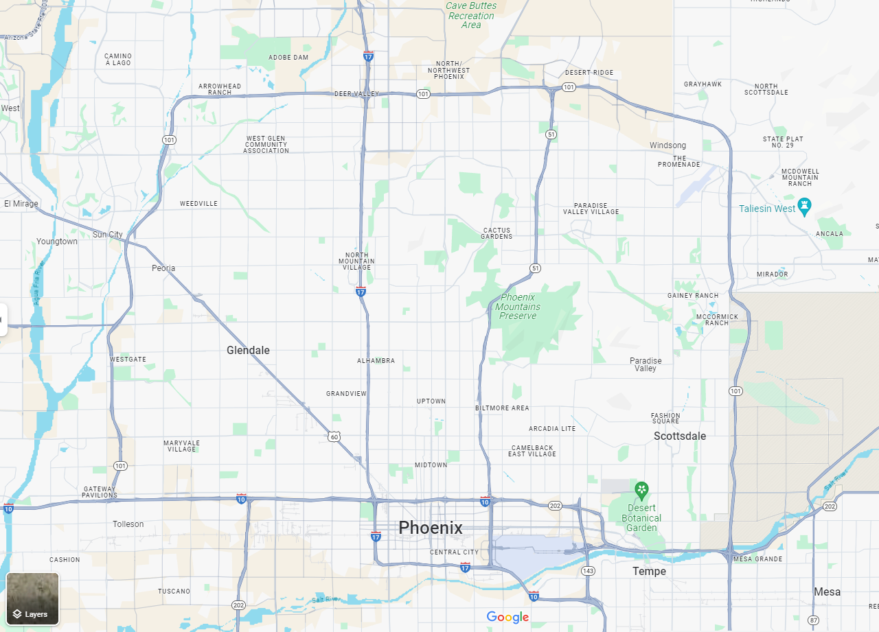
ORB REVIT
PROJECT BROWSER
ORGANIZATION
ORB University
ORB UNIVERSITY – April 22ND, 2025 PRESENTED BY Andres Fernandez

Slide 2
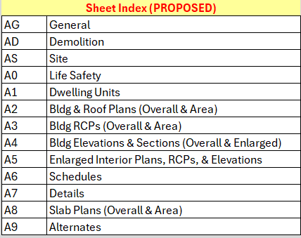

Slide 3
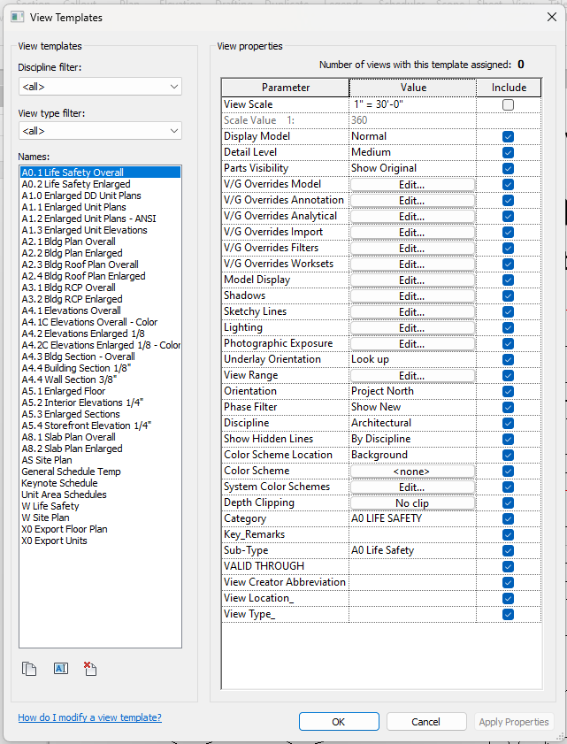

Slide 4
STANDARDS WILL PROVIDE 80%
WE PROVIDE THE REMAINING 20%

Slide 5
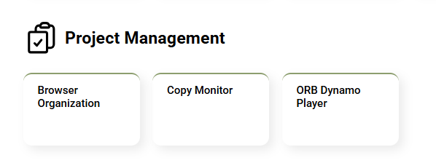
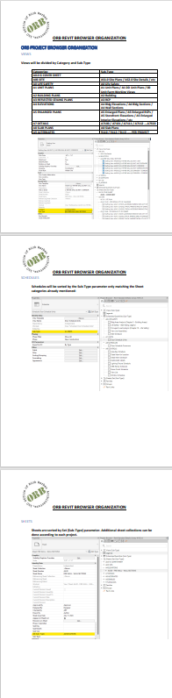

Slide 6
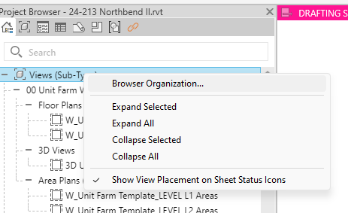
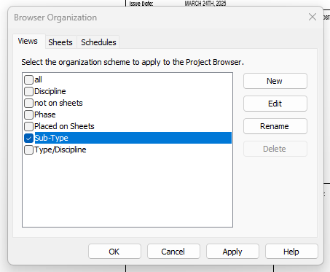
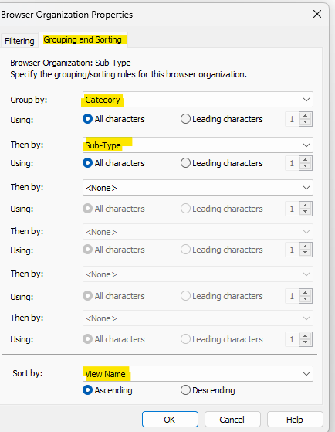

Slide 8
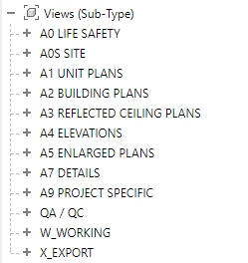
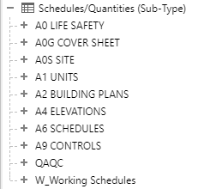
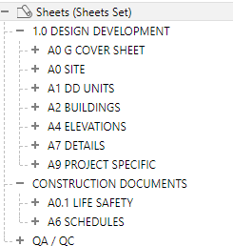
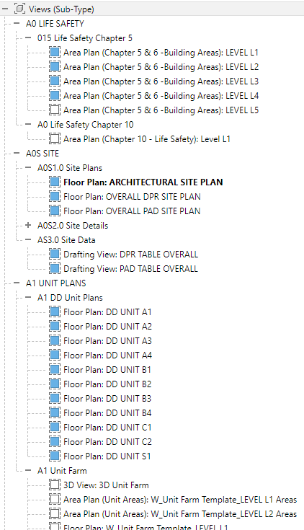

Slide 9
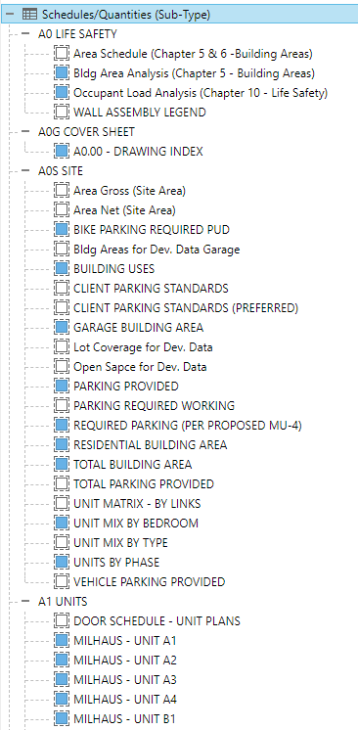

Slide 10
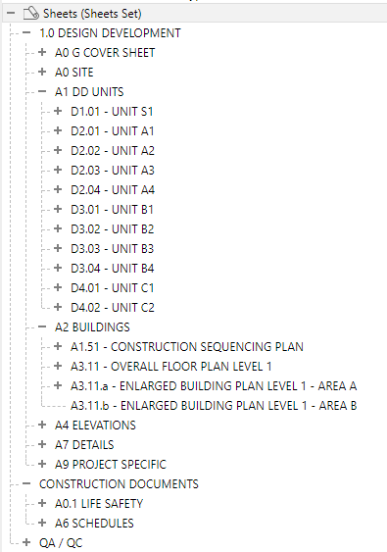

Slide 12
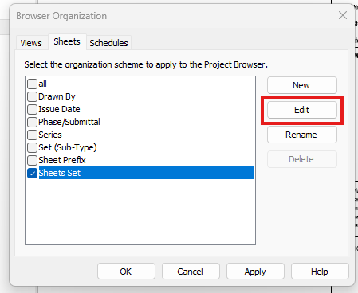
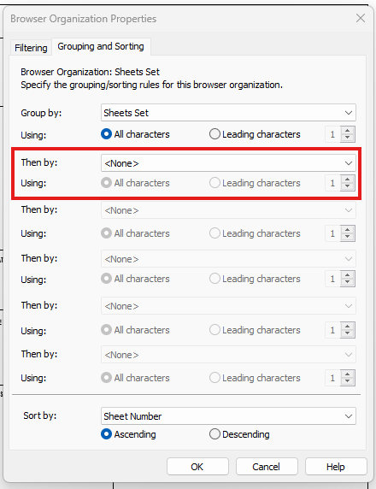

Slide 14
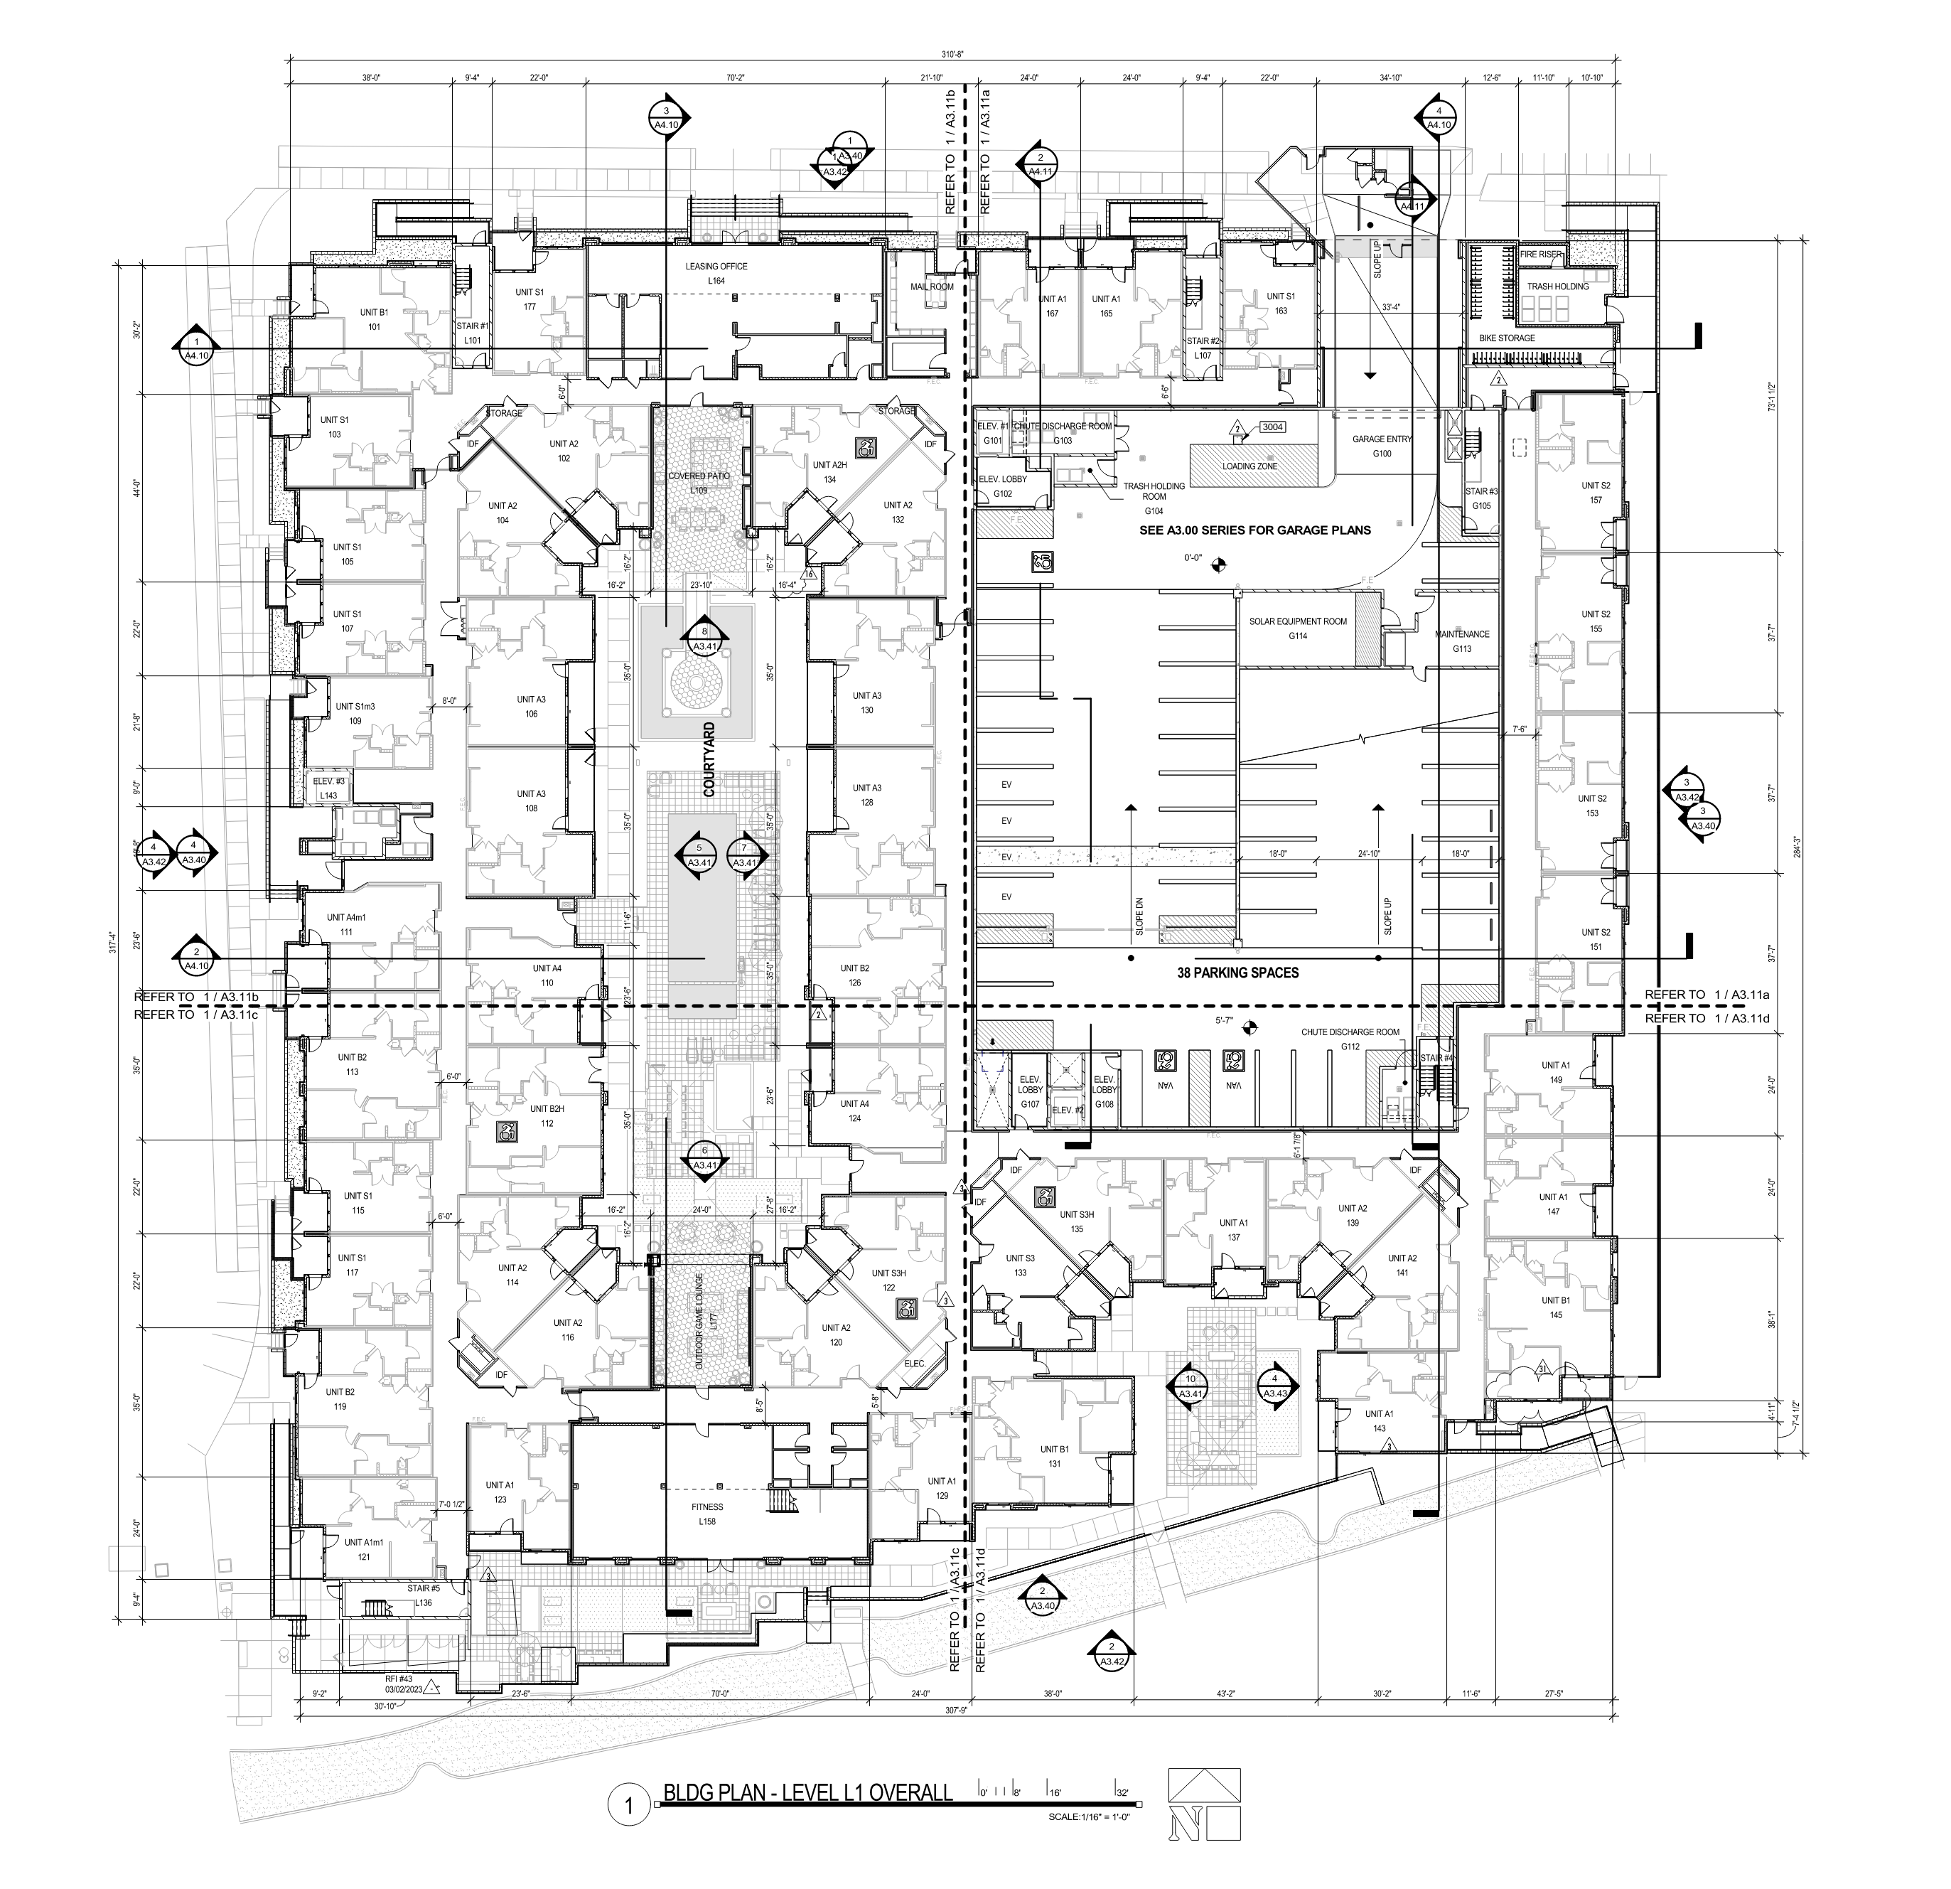
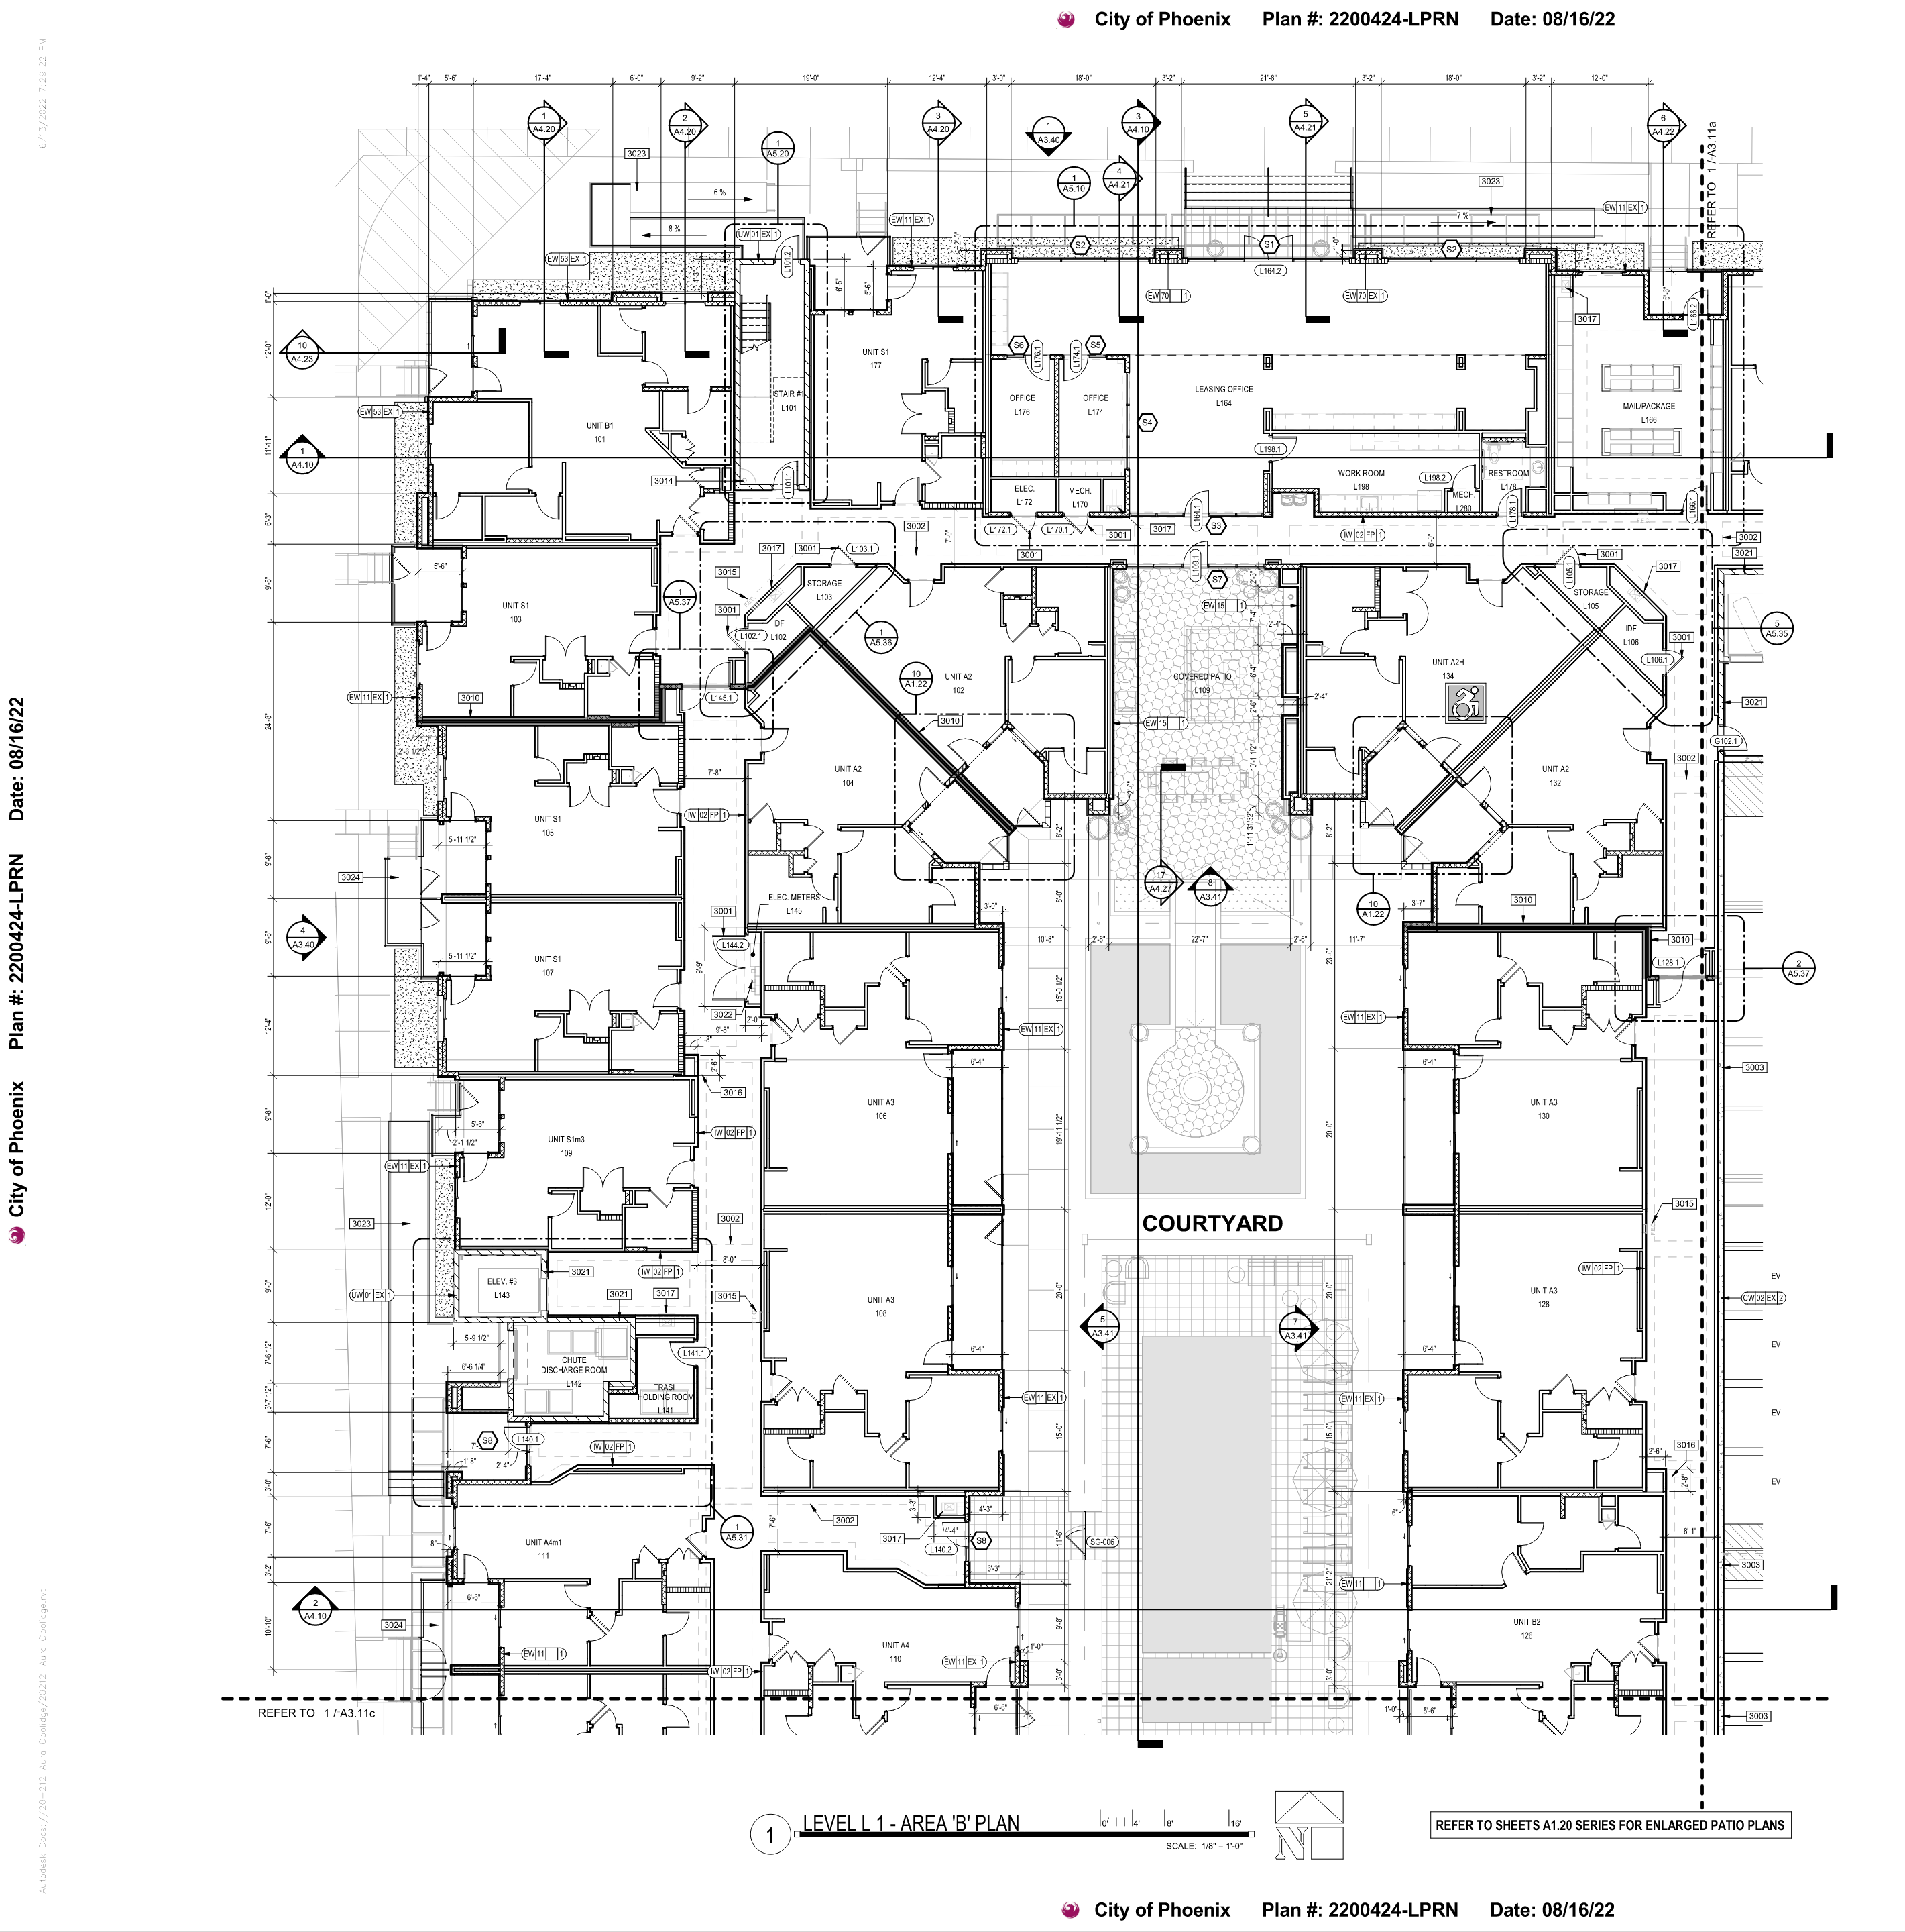
OVERALL PLANS:
EXTERIOR ELEVATIONS
OVERALL BUILDING SECTIONS
OVERALL DIMENSIONS
MATCH LINES
TYPE A UNIT LOCATIONS

Slide 15
ENLARGED PLANS:
UNIT TYPES AND NUMBERS
ENLARGED PLAN CALLOUTS
ENLARGED SECTION CALLOUTS
WALL SECTIONS
ENLARGED PLANS ARE MORE “WAYFINDING PLANS”

